Slide 1
Where to Open an Italian Restaurant in Boston?
Deniz aytemiz

Slide 2
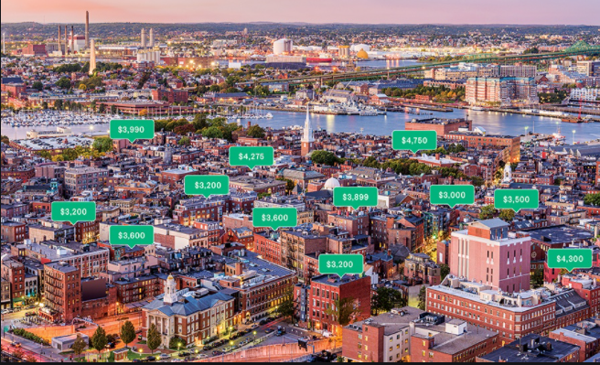
In this project; I examined the areas of Boston city for a person considering opening an Italian restaurant.
Data on number of Italian restaurants around the area, the popularity of the area, safety of the area, the housing prices of the area and the restaurant rankings around the area will give a description of the areas.
These areas are determined by distinct postal codes.

Slide 3
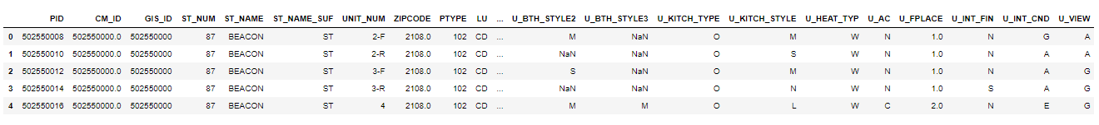
Data Acquisation and Cleaning
Foursquare data for nuber of Italian restaurants in a postal code area, id of venues, latitude and longitude, ratings of Italian Restaurants and number of tips.
House prices in Boston and Crime Incidents in Boston datasets from www.boston.gov.tr

Slide 4
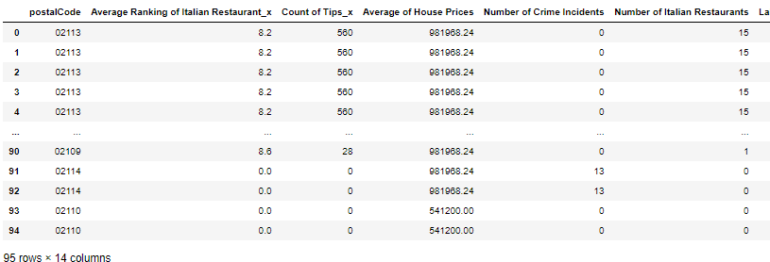
Final Dataframe after cleaning and merging with other dataframes

Slide 5
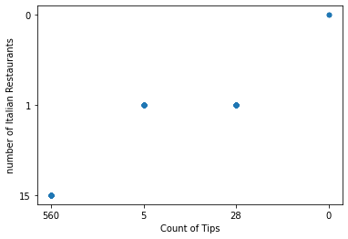
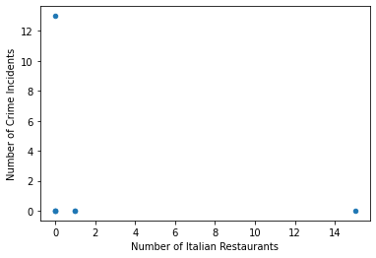
Feature Set
Feature set is number of Italian Restaurants, Number of Crime Incidents, Average House Price, Total Number of Tips, Average ratings of Italian Restaurants.
Correlation among Features:
Positive correlation between count of tips and number of Italian restaurants and no correlation between crime rates and number of Italian restaurants.

Slide 6
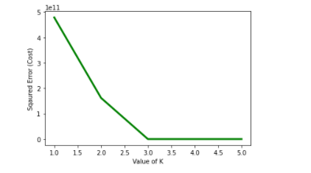
Model
K-means for modelling is used, since the aim is to cluster the postal code areas into groups.
Selecting the optimal k value:
Elbow point is k=3, hence that is the optimal value.

Slide 7
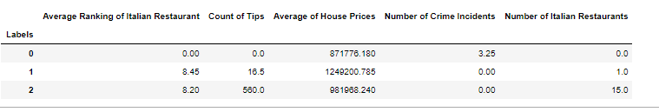
Model Result
What this labels indicate can be interpreted from the below table;
Label 0 can be interpreted as, low ranking, low popularity, cheaper house prices, high rates of crime with very few Italian Restaurants.
Label 1 indicates places with, very high rankings, average popularity, expensive housing prices, minimum crime incidents and few Italian Restaurants.
Label 2 indicates popular areas with high rankings, average housing prices, low rates of crime and many Italian Restaurants.

Slide 8
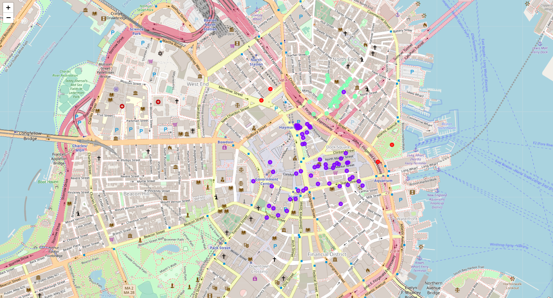
The Map after the labels are assigned to the postal codes

